Slide 1
Gdańsk, 3/12/2015
Impossible Tokens,
Necessary Types
“A Legisign is a law that is a Sign […]. Nor would the Replica be significant if it were not for the law which renders it so”.
Charles Sanders Peirce
Lorenzo Passerini Glazel
Università di Milano – Bicocca
lorenzo.passerini@unimib.it

Slide 2
Impossible Tokens, Necessary Types
1. Eidographic predicates vs. idiographic predicates
2. Properties being transmitted: an asymmetry between eidographic and idiographic predicates
3. Extrinsic effects of non-institutional acts vs. intrinsic effects of institutional acts
4. Two forms of atypicalness: privative atypicalness vs. negative atypicalness
5. Analogical types vs. katalogical types

Slide 3
1.
Eidographic predicates vs. idiographic predicates

Slide 4
“The faithful dog - why should I strive to speak his merits, while they live in every breast, and man's best friend does often at his heels attend.”
(The New-York Literary Journal, volume 4, 1821)
1. Eidographic predicates vs. idiographic predicates
2 of 20
Eidographic¹ predicates
Idiographic² predicates
1. “Dog is man’s best friend”.
3. “In the game of rugby, a try is worth five points”.
5. “According to Italian law, in the absence of a contrary stipulation, from marriage derives the community of property between the spouses”.
2. “His dog Gilbert is his best friend”.
4. “Goromaru’s try in South Africa v. Japan match on last Saturday turned the tide of the game”.
6. “Andrea and Francesca’s marriage took place on a bright sunny day, September 29th, 2012”.
¹ Cfr. Amedeo Giovanni Conte (*1924)
² Cfr. Wilhelm Windelband (1848-1915)
Notes:
Italian legal philosopher Amedeo Giovanni Conte.

Slide 5
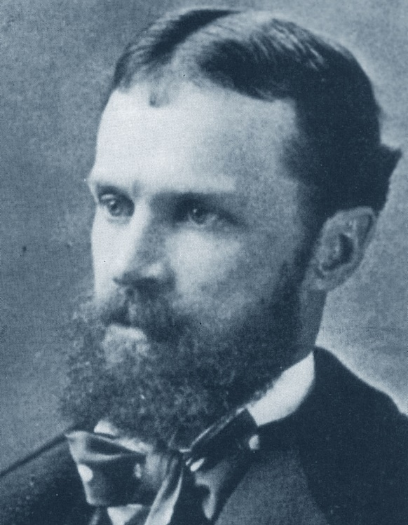
Type vs. token paradigm
1. Eidographic predicates vs. idiographic predicates
3 of 20
“In [a] sense of the word “word,” there is but one word “the” in the English language; and it is impossible that this word should lie visibly on a page or be heard in any voice, for the reason that it is not a Single thing or Single event. It does not exist; it only determines things that do exist. Such a definitely significant Form, I propose to term a Type”.
(Ch. S. Peirce 1960, 4.537, vol. IV, 423)
“A single event which happens once and whose identity is limited to that one happening or a Single object or thing which is in some single place at any one instant of time, such event or thing being significant only as occurring just when and where it does, such as this or that word on a single line of a single page of a single copy of a book, I will venture to call a Token”.
(Ch. S. Peirce 1960, 4.537, vol. IV, 423)
Charles Sanders Peirce (1839-1914)

Slide 6
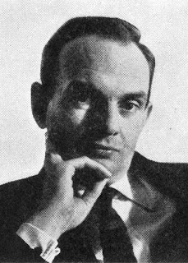
“What are the characteristic circumstances in which we postulate a type?”
1. Eidographic predicates vs. idiographic predicates
4 of 20
“A very important set of circumstances in which we postulate types […] is where we can correlate a class of particulars with a piece of human invention: these particulars may then be regarded as tokens of a certain type”.
(R. Wollheim, Art and Its Objects, 1968, p. 94)
Class: e.g. the class of small objects.
Universal: e.g. smallness.
Type: e.g. the Union Jack.
Richard Arthur Wollheim (1923-2003)

Slide 7
2.
Properties being transmitted:
an asymmetry between eidographic and idiographic predicates

Slide 8
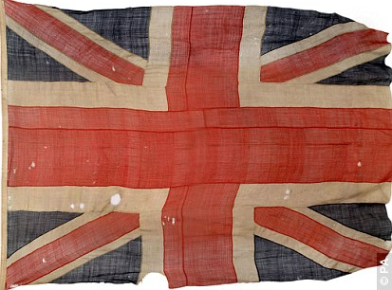

2. Properties being transmitted: an asymmetry between eidographic and idiographic predicates
6 of 20
The type of the Union Jack
A battle-scarred token of the Union Jack
The type Union Jack
cannot get battle-scarred
(the only one now surviving from Trafalgar battle,
sold for £ 384,000/ zł 2,321,719 in 2009)

Slide 9
2. Properties being transmitted: an asymmetry between eidographic and idiographic predicates
7 of 20
Eidographic predicates
Idiographic predicates
3. “In the game of rugby, a try is worth five points”.
8*. “In the game of rugby, a try turns the tide of the game”.
7. “Goromaru’s try in South Africa v. Japan match on last Saturday was worth five points”.
4. “Goromaru’s try in South Africa v. Japan match on last Saturday turned the tide of the game”.

Slide 10
2. Properties being transmitted: an asymmetry between eidographic and idiographic predicates
8 of 20
Eidographic predicates
Idiographic predicates
5. “According to Italian law, in the absence of a contrary stipulation, from marriage derives the community of property between the spouses”.
10*. “According to Italian law, marriage takes place on a bright sunny day, September 29th, 2012”.
9. “From Andrea and Francesca’s marriage derived the community of property between them”.
6. “Andrea and Francesca’s marriage took place on a bright sunny day, September 29th, 2012”.

Slide 11
3.
extrinsic effects of
non-institutional acts
vs.
Intrinsic effects of
institutional acts

Slide 12
3. Extrinsic effects of non-institutional acts vs. intrinsic effects of institutional acts
10 of 20
Extrinsic (causal) effects of non-institutional acts
Intrinsic (non-causal) effects of institutional acts
Cutting down a tree
Running
Marrying
Scoring a try
Institutional normative relationship of “imputation”,¹
determined by the type
Token-to-token cause-effect relationship, not determined by the type
The tree falls down
The body changes relatively quickly its position in space
The community of property between the spouses is constituted
The scorer’s team earns five points
Institutional normative relationship of “imputation”,
determined by the type
Token-to-token cause-effect relationship, not determined by the type
¹ Cfr. Hans Kelsen (1881-1973)

Slide 13
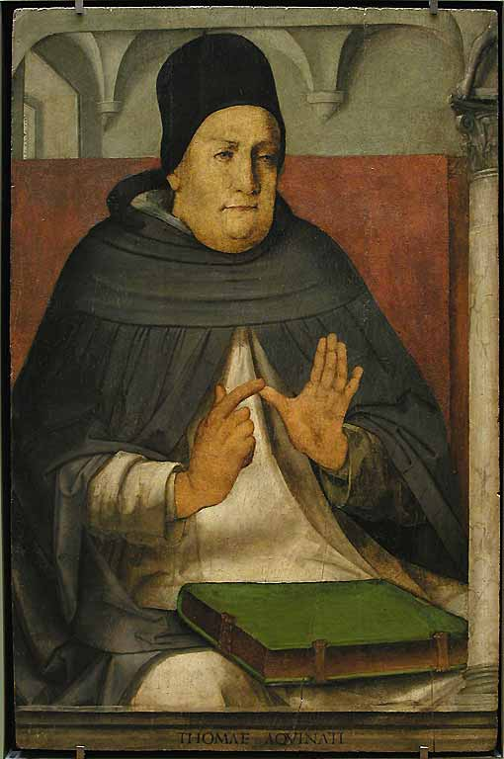
The type of an institutional act is the (necessary) causa prima of the effects of its tokens; every token is a (contingent) causa secunda of those effects: a causa secunda that “triggers” the effects determined by the type.
4. Extrinsic effects of non-institutional acts vs. intrinsic effects of institutional acts
11 of 20
“Effectus plus dependet a causa prima quam a causa secunda, quia secunda causa non agit nisi in virtute primae causae”.
“The effect depends more on the causa prima than on a causa secunda, since a causa secunda acts only in virtue of the causa prima”.
(Thomas Aquinas, Summa theologiae, Iª-IIª, q. 19, art. 4)
Thomas Aquinas (1225-1274)

Slide 14
4.
two forms of atypicalness:
privative atypicalness
vs.
negative atypicalness

Slide 15
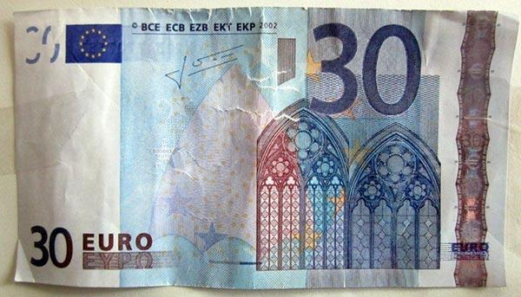


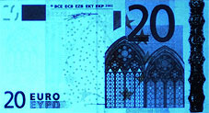
3. Two forms of atypicalness: privative atypicalness vs. negative atypicalness
13 of 20
Privative atypicalness
(steretic,¹ scalar atypicalness)
Deviation from a given type,
partial non-conformity with reference to a type.
Negative atypicalness
(apophatic,¹ binary atypicalness)
Typelessness, irreducibleness to any existing type.
¹ On st○rhsiw stérēsis vs. pfasiw apóphasis, cfr. Aristotle (384-322 BC), On Interpretation, Categories, Metaphysica, passim.

Slide 16
3. Two forms of atypicalness: privative atypicalness vs. negative atypicalness
14 of 20
Privative atypicalness
Negative atypicalness
The atypicalness of a fake (counterfeit) 20 € banknote.
The atypicalness of a lease contract in which something different from money is the consideration for lease.
The atypicalness of a 30 € banknote.
The atypicalness of scoring a try in football (soccer).
The atypicalness of castling in draughts: “There is no castling in draughts” (L. Wittgenstein).
Privative atypicalness presupposes the existence of a reference type.
Negative atypicalness is determined by the non-existence of a reference type.
Notes:
Dülmen (Westfalen), May, 2013.

Slide 17
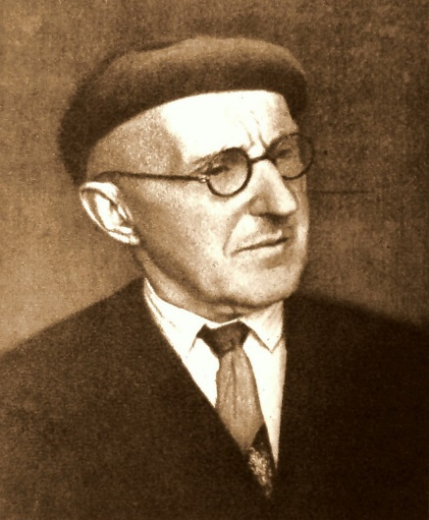
Negative atypicalness and normative impossibility
3. Two forms of atypicalness: privative atypicalness vs. negative atypicalness
15 of 20
Negative atypicalness
Ontological normative impossibility:
a normative impossibility which originates (not from the presence of an impeding norm, but) from the absence of specific rules constituting the type.
(Cfr. Amedeo G. Conte and Paolo Di Lucia, 2012)
“All these acts could not exist (that is, it wouldn’t be possible to perform them), if the norm constituting them didn’t exist.
As well as it is impossible to “capture a pawn” without the laws of chess, it is impossible to donate a horse to anybody without the norms instituting legal property and the [type of] act of donation”.
Cz. Znamierowski,1924
Czesław Znamierowski
(1888-1967)

Slide 18
5.
analogical Types
vs.
katalogical types

Slide 19
5. Analogical types vs. katalogical types
17 of 20
Analogical types
Katalogical¹ types
An analogical type is obtained per analogiam and abstraction from the its tokens.
Properties are transmitted in an upward direction (aná-basis), from the tokens to the type: the type mirrors the properties of its tokens.
The tokens are the prius, the type is the posterius.
Prevailing cognitive function, and epistemological import.
A token is obtained per katalogiam (instantiation) from its katalogical type.
Properties are transmitted in a downward direction (kata-basis) from the type to the tokens: the type determines the properties of its tokens.
The type is the prius, the tokens are the posterius.
Prevailing normative function, and ontological import.
¹ Cfr. Alexander Gerken; Hans Urs von Balthasar (1905-1988)

Slide 20



5. Analogical types vs. katalogical types
18 of 20
Analogical types
Katalogical types
Type-to-tokens direction of fit:¹
an analogical type has to fit its tokens in order to be cognitively correct.
Cognitive expectations:²
in case of non-correspondence between the type and its tokens, it is the type that has to be revised.
Tokens-to-type direction of fit:¹
a token has to fit its katalogical type in order to exist (to be ontologically correct) and to produce its effects.
Normative expectations:²
in case of non-correspondence between the type and a token, it is the token that has to be revised.
¹ Cfr. Thomas Aquinas (1225-1274); G.E.M. Anscombe (1919-2001); John R. Searle (*1932)
² Cfr. Johan Galtung (*1930)

Slide 21
5. Analogical types vs. katalogical types
19 of 20
Analogical types
Katalogical types
The truth-canon (criterion of truth) for eidographic predicates referring to analogical types is not type: it is the tokens
The truth-canon for eidographic predicates referring to katalogical types is the type itself
Natural ontology as an ontology of tokens
Institutional ontology as an ontology of types

Slide 22
5. Analogical types vs. katalogical types
20 of 20
“Veritas consistit in adaequatione intellectus et rei […]. Intellectus autem qui est causa rei, comparatur ad ipsam sicut regula et mensura, e converso autem est de intellectu qui accipit scientiam a rebus.
Quando igitur res sunt mensura et regula intellectus, veritas consistit in hoc, quod intellectus adaequatur rei, ut in nobis accidit, ex eo enim quod res est vel non est, opinio nostra et oratio vera vel falsa est.
Sed quando intellectus est regula vel mensura rerum, veritas consistit in hoc, quod res adaequantur intellectui, sicut dicitur artifex facere verum opus, quando concordat arti”.
“Truth consists in a correspondence between the intellect and reality. Now an intellect that is a cause of the relevant real thing is related to it as a rule and measure, whereas the converse holds in the case of an intellect that takes its scientific knowledge from the things.
Thus, when, as happens with us, the things are the measure and rule of the intellect, then truth consists in the intellect’s corresponding to the thing. For it is because reality is or is not such-and-such that our opinions and statements are true or false.
By contrast, when the intellect is the rule or measure of the things, then truth consists in the thing’s corresponding to the intellect. So, for instance, the craftsman is said to produce a true work when that work agrees with his craft”.
(Thomas Aquinas, Summa theologiae, Iª-II^{ae}, q. 19, art. 4)

Slide 23
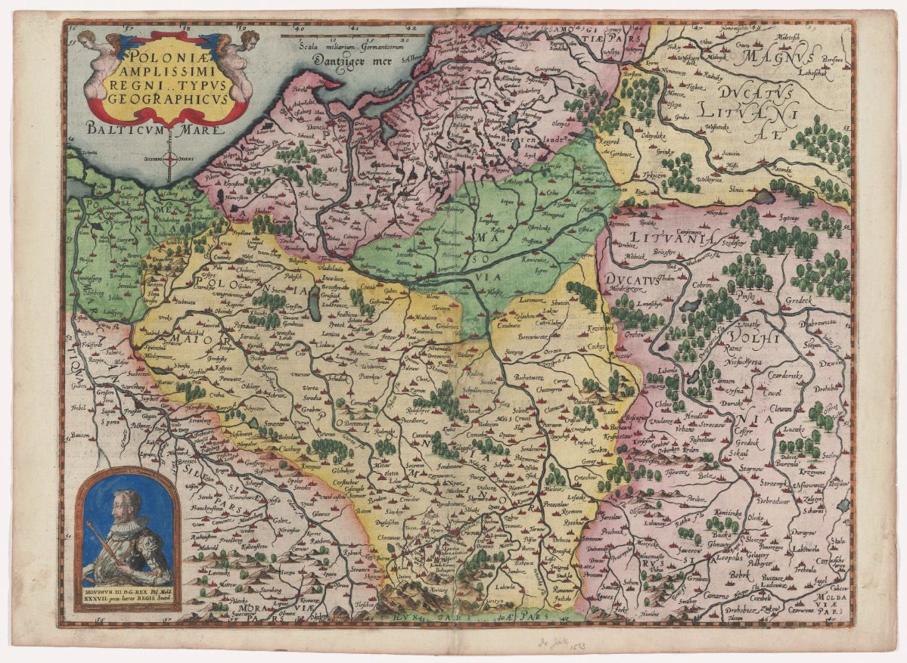
"Poloniae amplissimi regni .. Typus geographicum"
Extracted from Gerard de Jode (1509-1591), Speculum orbis terrae, 1593.
© Image Delivery Service
Harvard University Library
lorenzo.passerini@unimib.it

