Slide 1
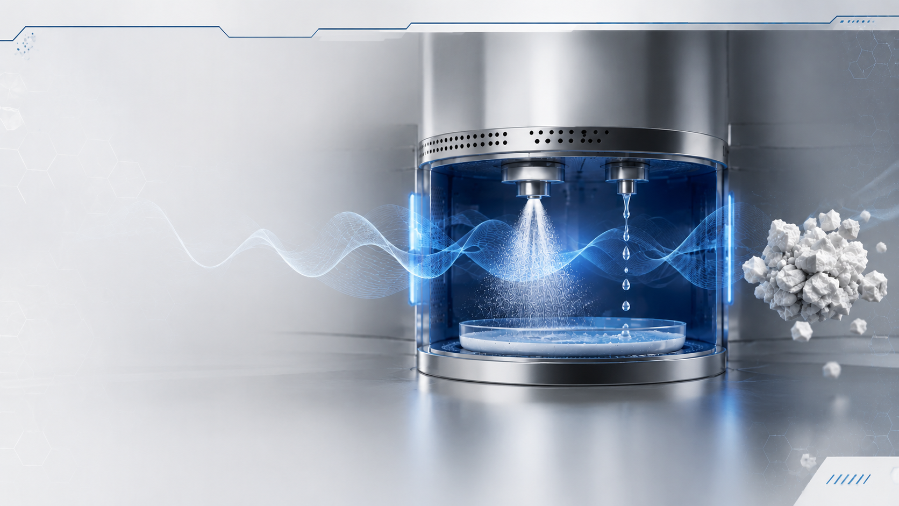

Microwave-Assisted Spray Carbonation of mineral slurries: Influence of
Injection Mode and Reaction Parameters on Carbonate Formation
Andrea Erroi, Andrea Rusconi, Marcello Campione
Department of Environmental and Earth Sciences,
University of Milano-Bicocca, Piazza della Scienza 4, Milano, Italy
SelSim2026 Symposium on microscopic characterization of the solid/liquid interface

Slide 2
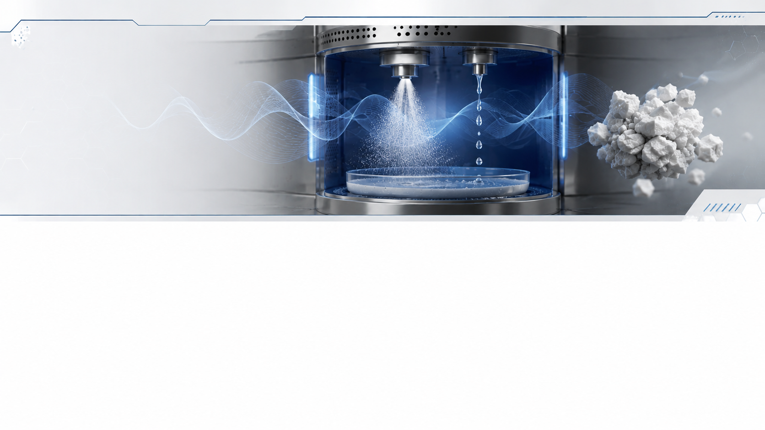
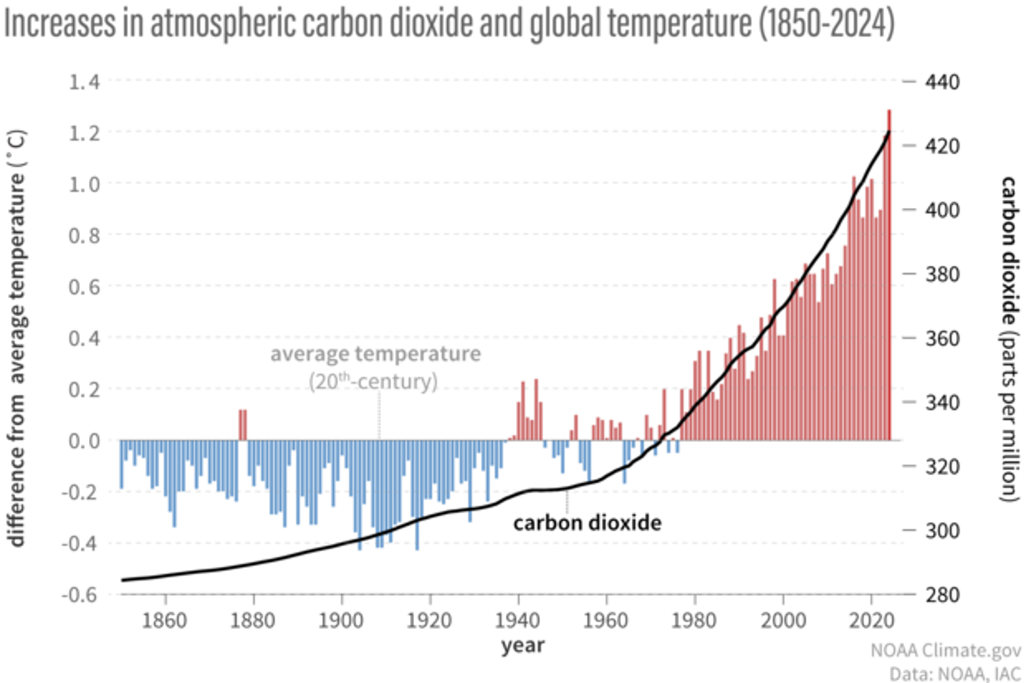
THE PROBLEM OF CO₂
Global warming: a rise in the Earth’s average temperature
Extreme weather events: heatwaves, droughts, floods and storms
The melting of the polar ice caps and the resulting rise in sea levels
Ecosystem disruption, loss of biodiversity, ocean acidification

Slide 3
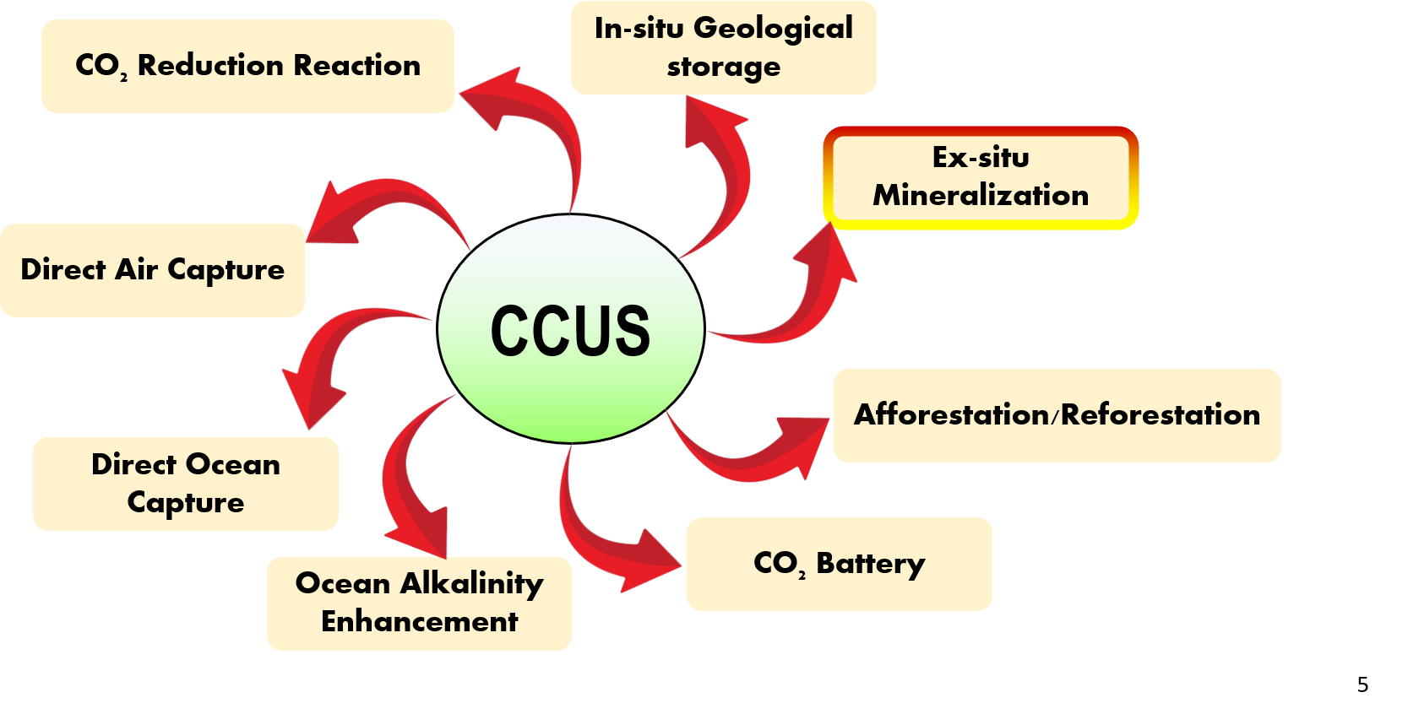
THE PROBLEM OF CO₂
Energy production from fossil fuels
Transport: cars, lorries, aeroplanes and ships
Steel manufacturers, cement producers, chemical industry
Buildings: heating and cooling systems
Agriculture and farming

Slide 4
HOW TO CAPTURE CO₂
In aqueous solution:
CO₂ (g) + H₂O (l) → CO₂ (aq)
CO₂ (aq) + H₂O (l) → H₂CO₃ (aq)
H₂CO₃ (aq) → HCO₃⁻ (aq) + H⁺ (aq)
HCO₃⁻ (aq) → CO₃⁻² (aq) + H⁺ (aq)
In an aqueous environment, CO₂ dissolves in water
A small proportion of the dissolved CO₂ undergoes hydration to form H₂CO₃
The equilibrium is heavily shifted to the left: only a small fraction of the dissolved CO₂ is present as true carbonic acid
Carbonic acid can subsequently dissociate and form HCO₃⁻ and CO₃⁻² ions
In basic solution:
CO₂ (g) + H₂O (l) → CO₂ (aq)
CO₂ (aq) + OH⁻ (aq) → HCO₃⁻ (aq)
HCO₃⁻ (aq) → CO₃⁻² (aq) + H⁺ (aq)
A basic solution helps CO₂ to dissolve, as it shifts the equilibrium, causing the formation of HCO₃⁻ and CO₃⁻² ions from CO₂ (aq)

Slide 5
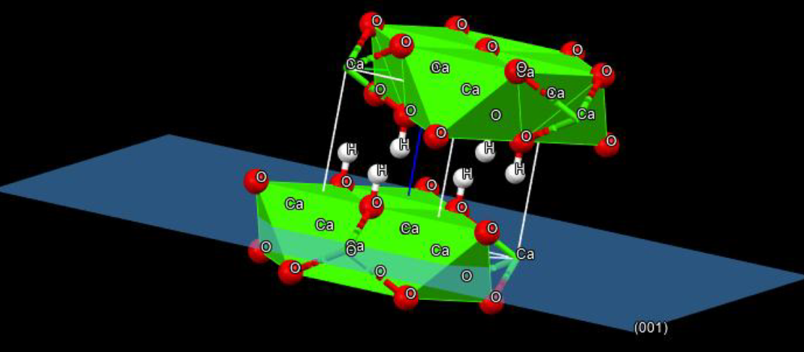
HOW TO CAPTURE CO₂
Ca(OH)₂ (aq) + CO₂ (g) → CaCO₃ (s) + H₂O (l)
Layered brucite-type structure
Ca²⁺ atom is octahedrally coordinated by six hydroxyl groups OH⁻ to give CaO₆ octahedra that share edges to form a two-dimensional sheet
The individual layers are held together by weak van der Waals forces and residual hydrogen bonds
Portlandite is highly soluble in water and thus releases OH⁻ ions, which promote the dissolution of CO₂, and Ca²⁺ ions, which form carbonates
Ca(OH)₂ (aq) → Ca²⁺ (aq) + OH⁻ (aq)
CO₂ (aq) + OH⁻ (aq) → HCO₃⁻ (aq)
HCO₃⁻ (aq) → CO₃⁻² (aq) + H⁺ (aq)
Ca²⁺ (aq) + CO₃⁻² (aq) → CaCO₃ (s)

Slide 6

HOW TO CAPTURE CO₂
Ca(OH)₂ (aq) + CO₂ (g) → CaCO₃ (s) + H₂O (l)
the lamellar nature allows water molecules and CO₂ to easily penetrate between the layers
A layer of water adsorbed on the crystal surface acts as an ionization medium, catalysing the transformation of CO₂ into carbonic acid (H₂CO₃) and facilitating the ion exchange
The coordination octagon of calcium is distorted by polyhedral rearrangement to accommodate the planar carbonate anion, changing from the layered structure of portlandite to the rhombohedral structure of calcite/aragonite
Lattice energy of CaCO₃ is significantly more stable than that of portlandite

Slide 7
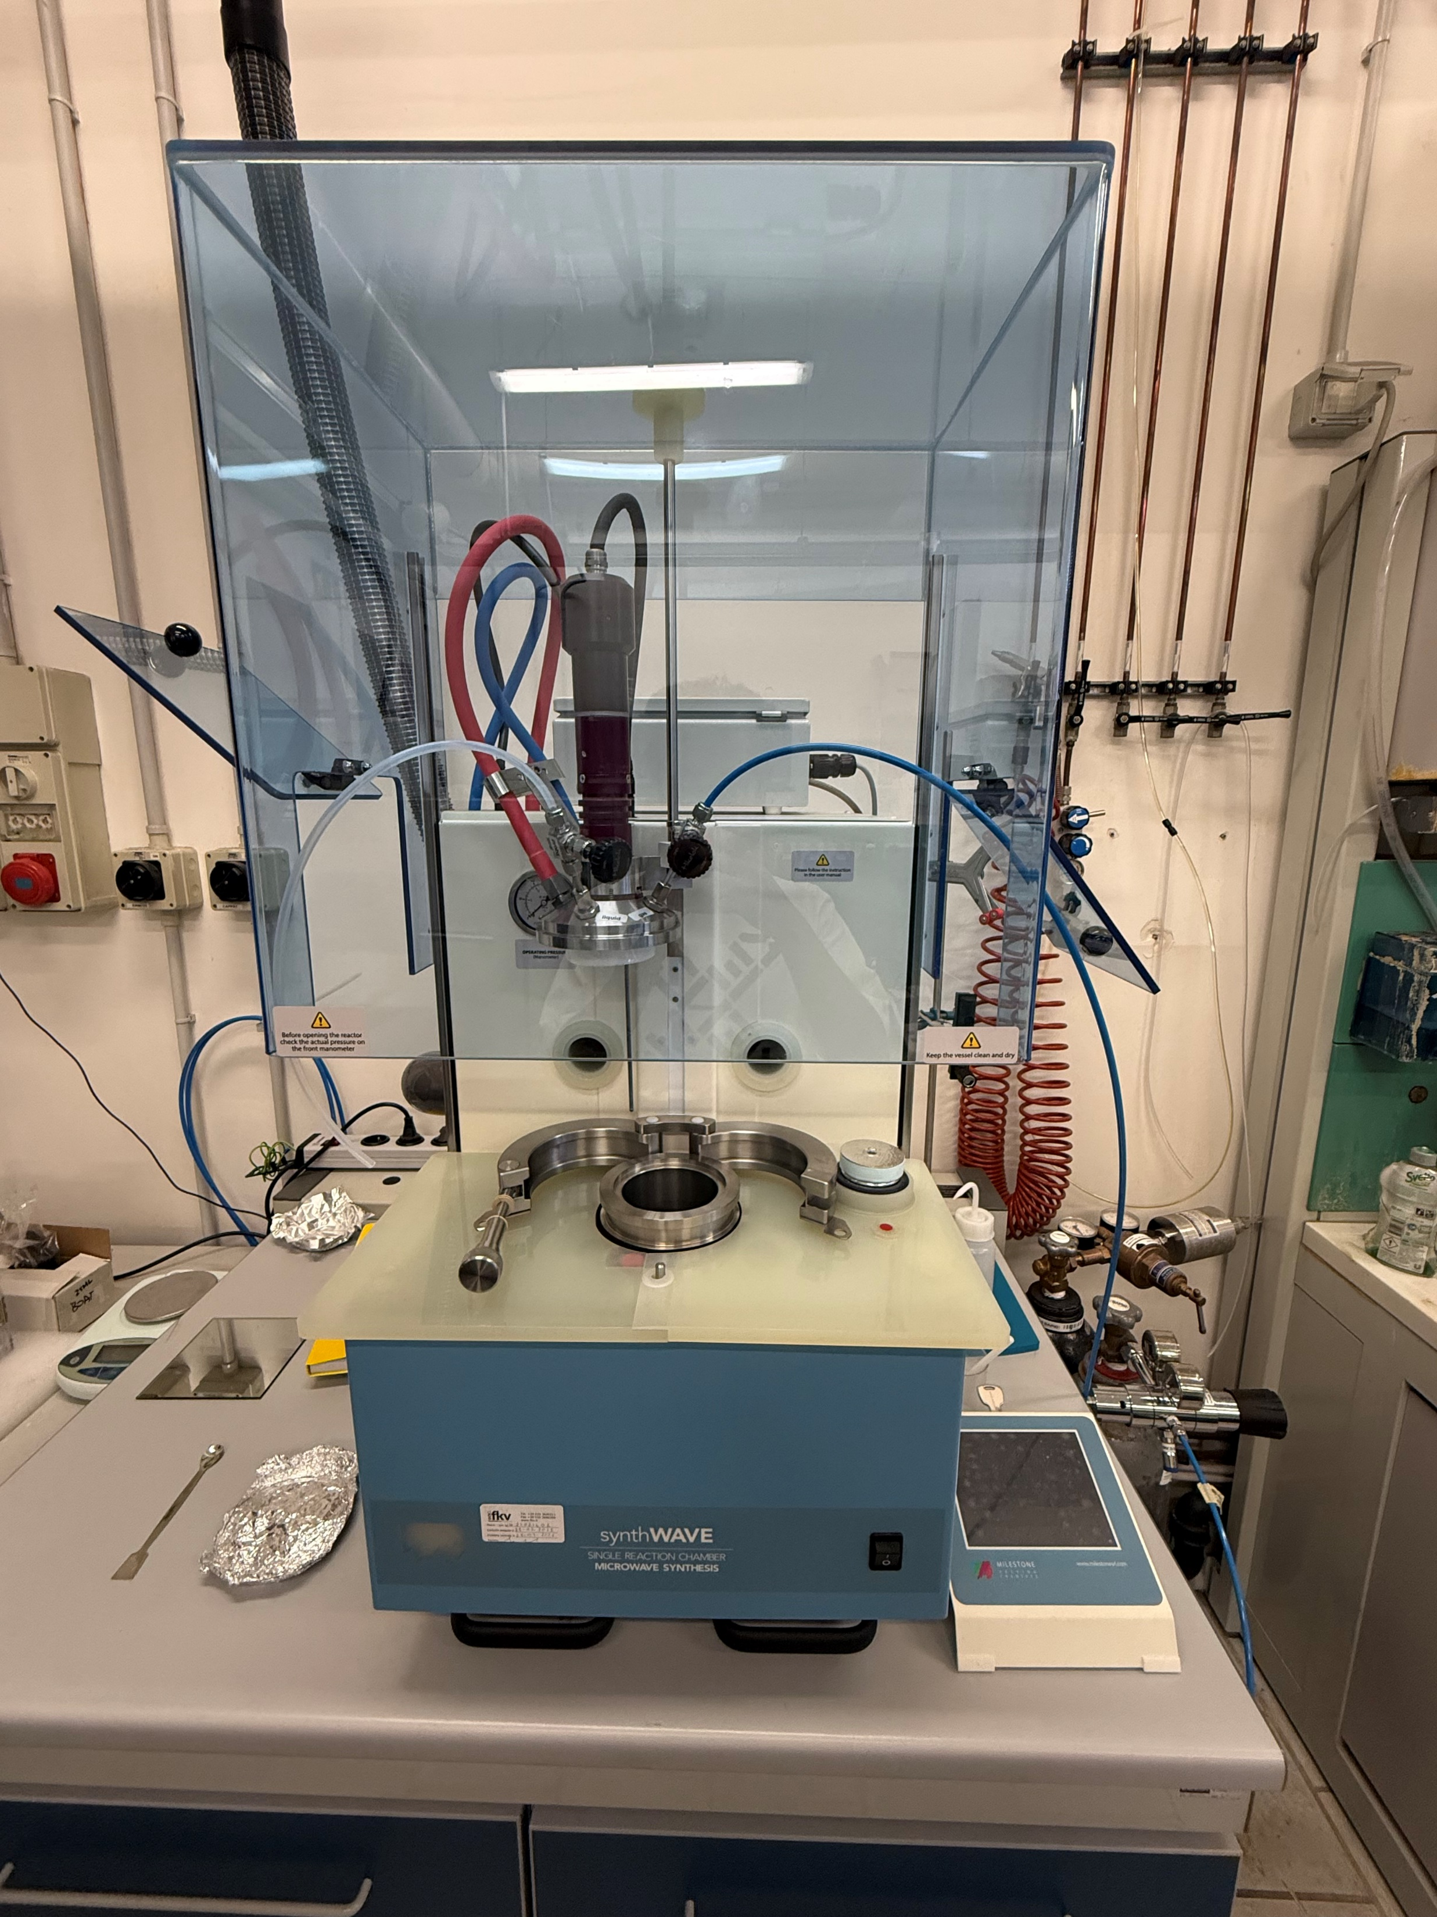
CLASSICAL
CARBONATION SET-UP
The carbonation of Portlandite is a spontaneous reaction that also takes place at room temperature
However, to increase the reaction rate, hydrothermal synthesis in sealed reactors is used
Temperature:
Increase ion mobility
Increase solubility of Ca(OH)₂
Accelerates the nucleation and growth of carbonate crystals
Increase the partial pressure of CO₂
Reduction of the synthesis duration
Control of polymorphs
Microwaves:
Efficient and faster heating
Minimisation of temperature gradients
Better temperature control

Slide 8
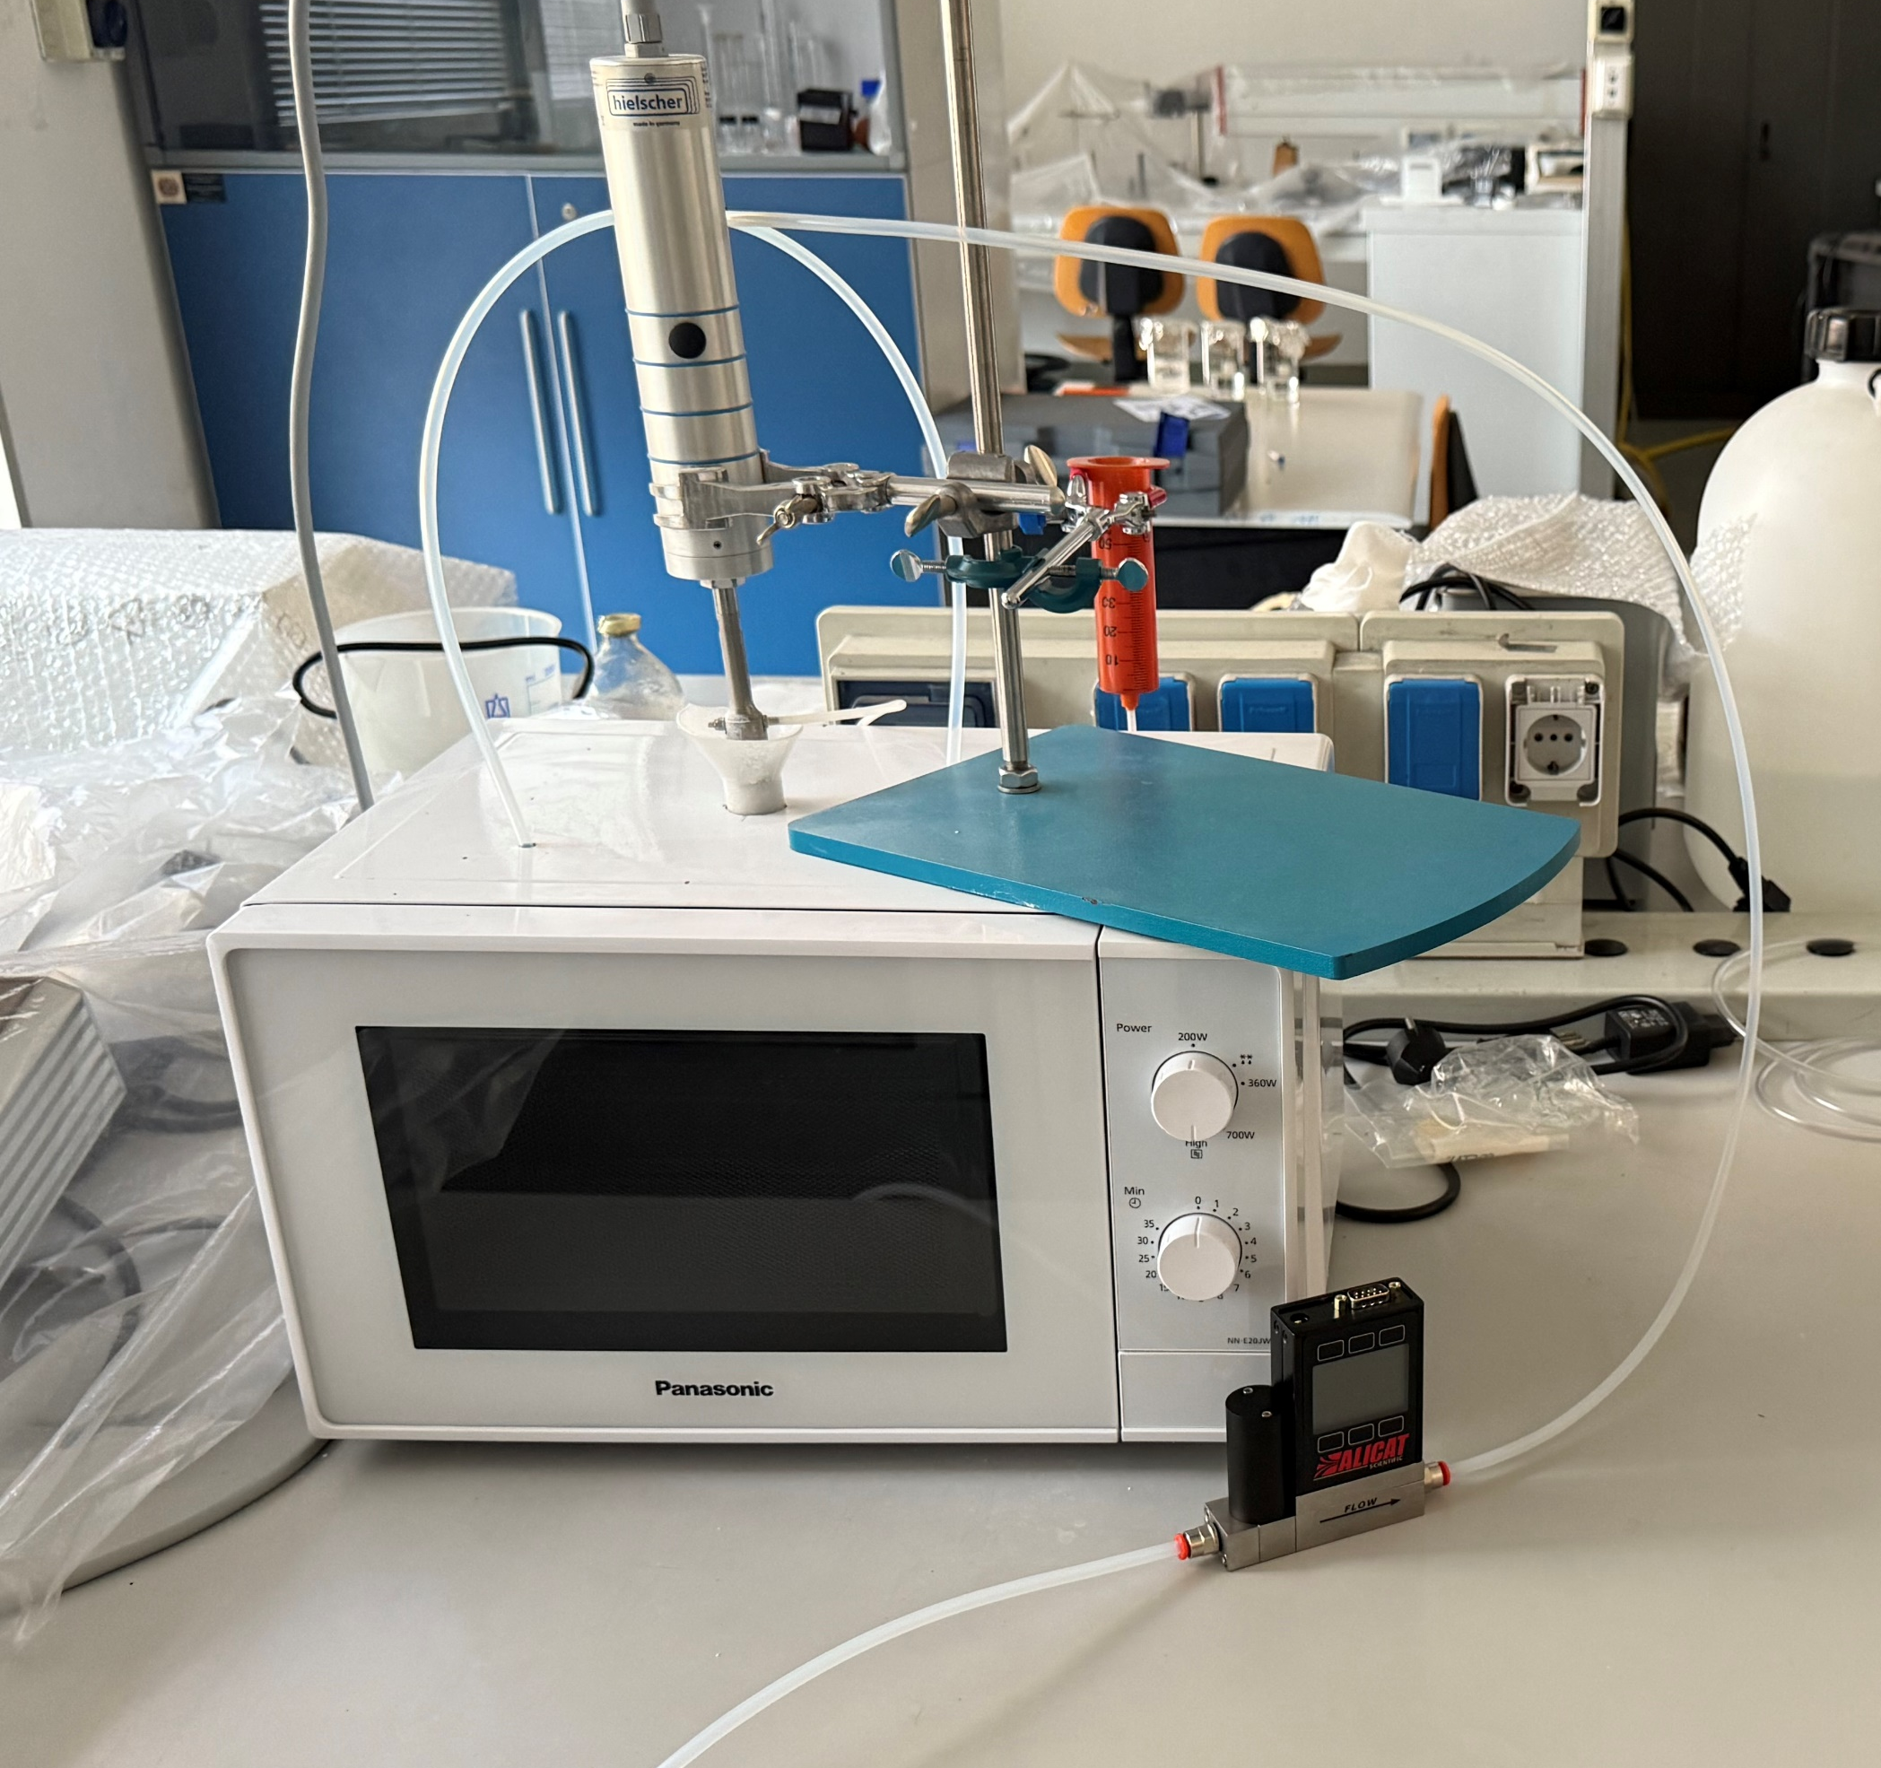
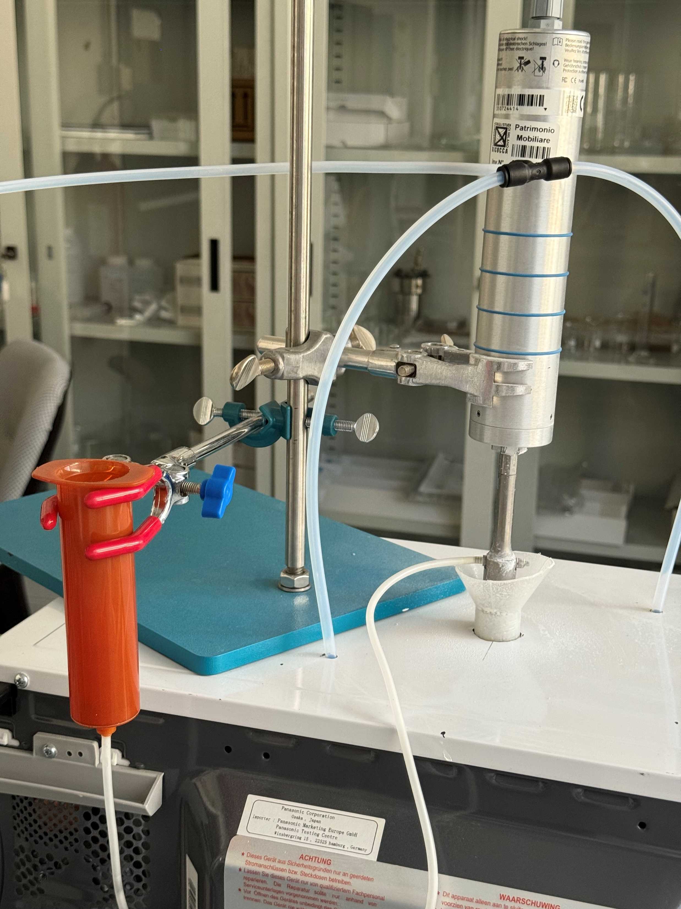
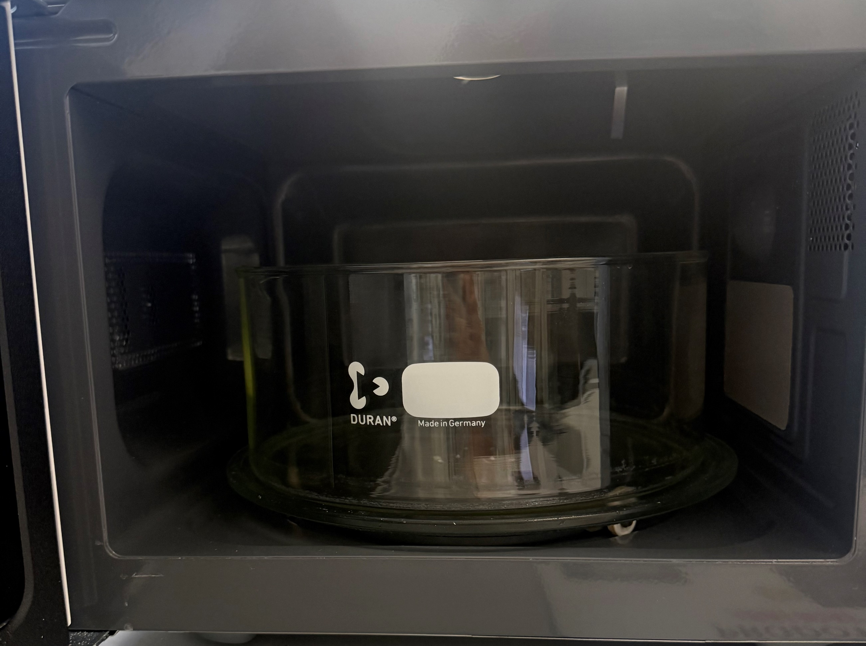
EXPERIMENTAL SET-UP
CO₂ tube
Slurry reservoir
Slurry injection system (spray/dropping)
Slurry injection system (spray/dropping)
CO₂ tube
Flux regolator
CO₂ tank

Slide 9
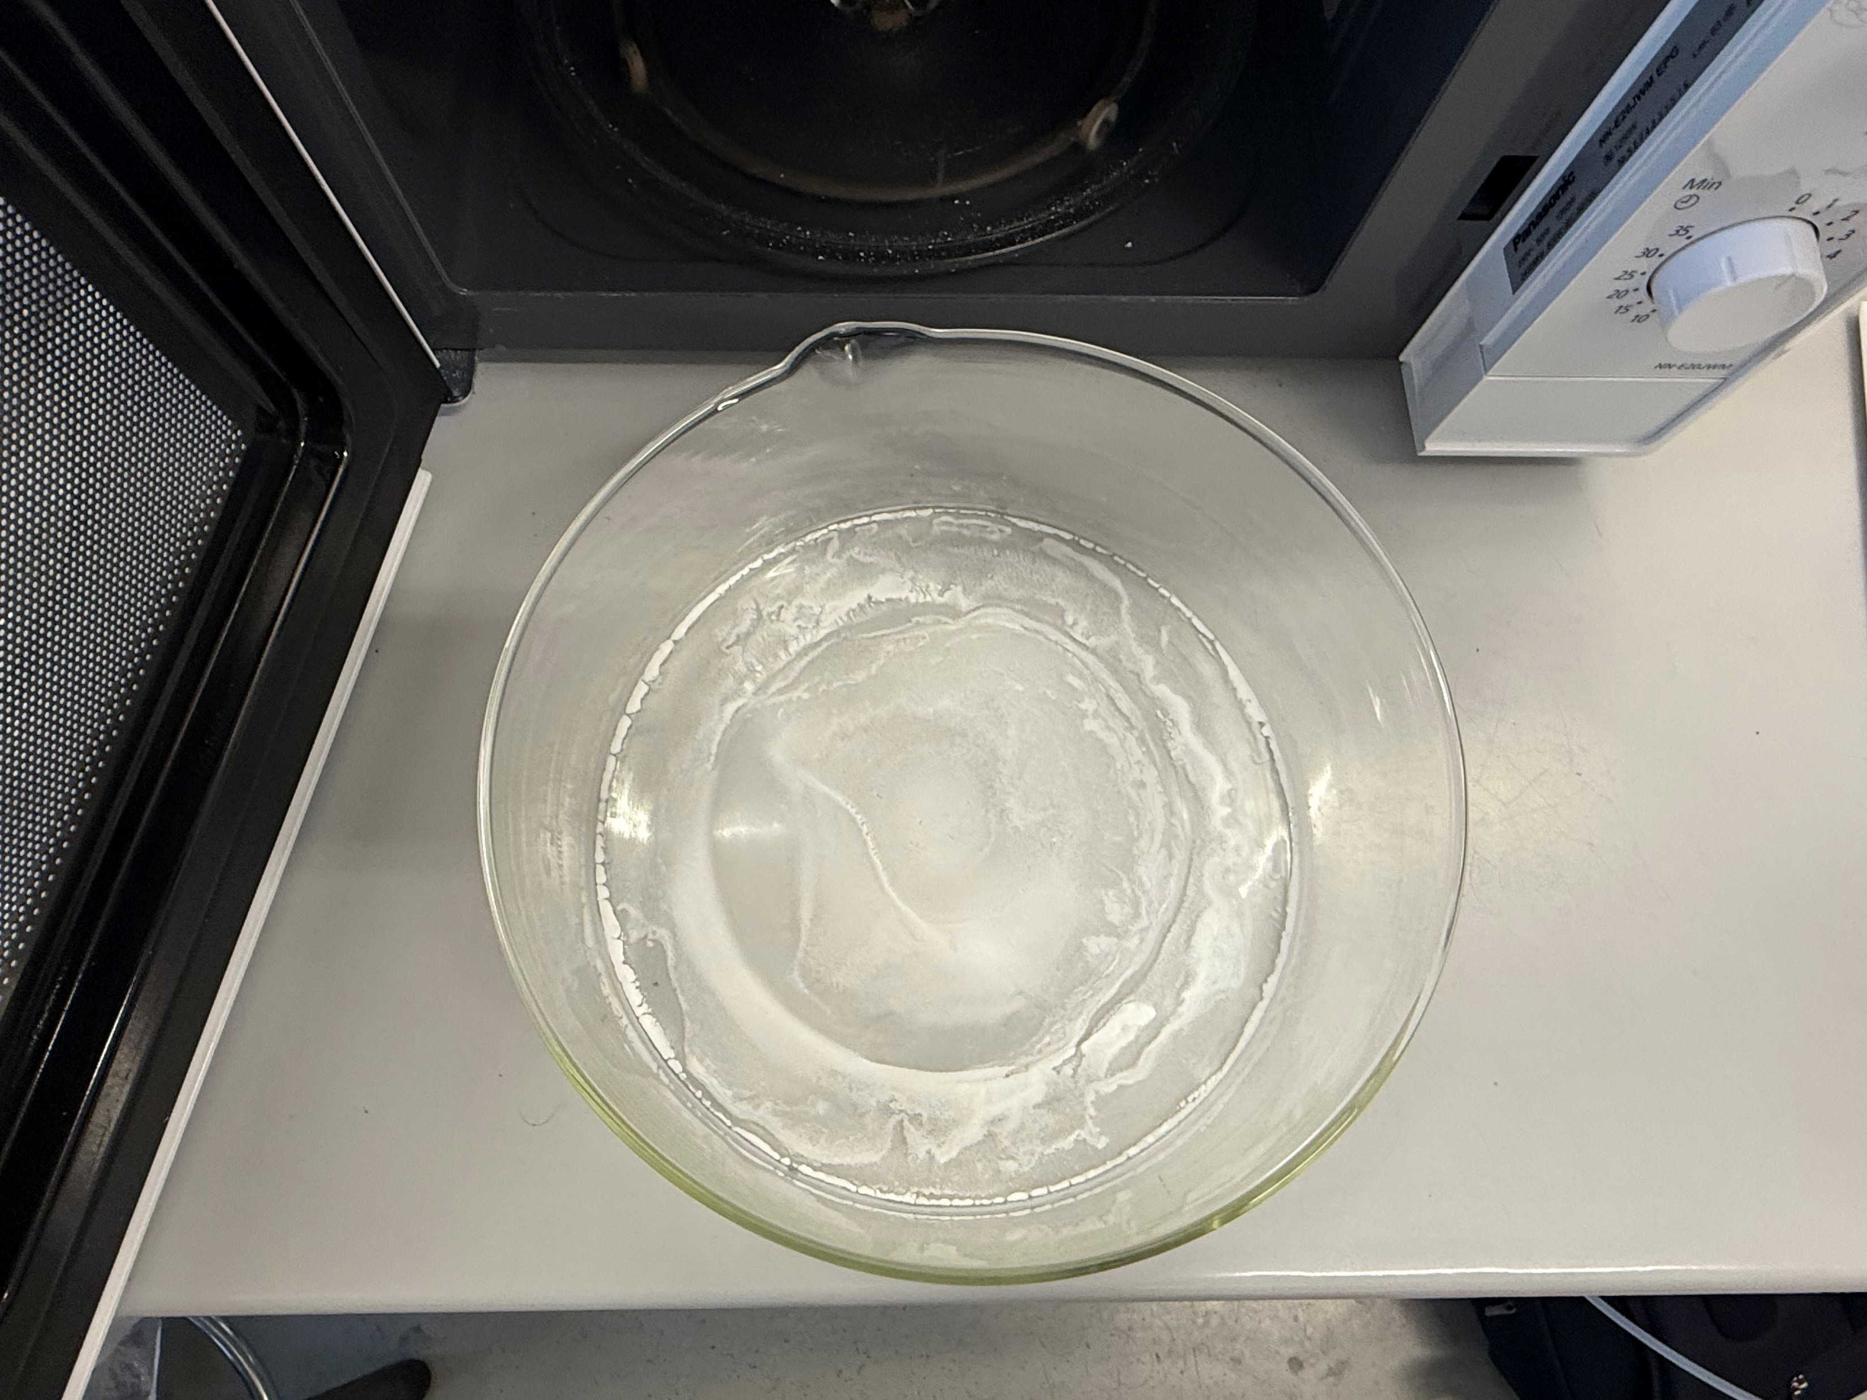
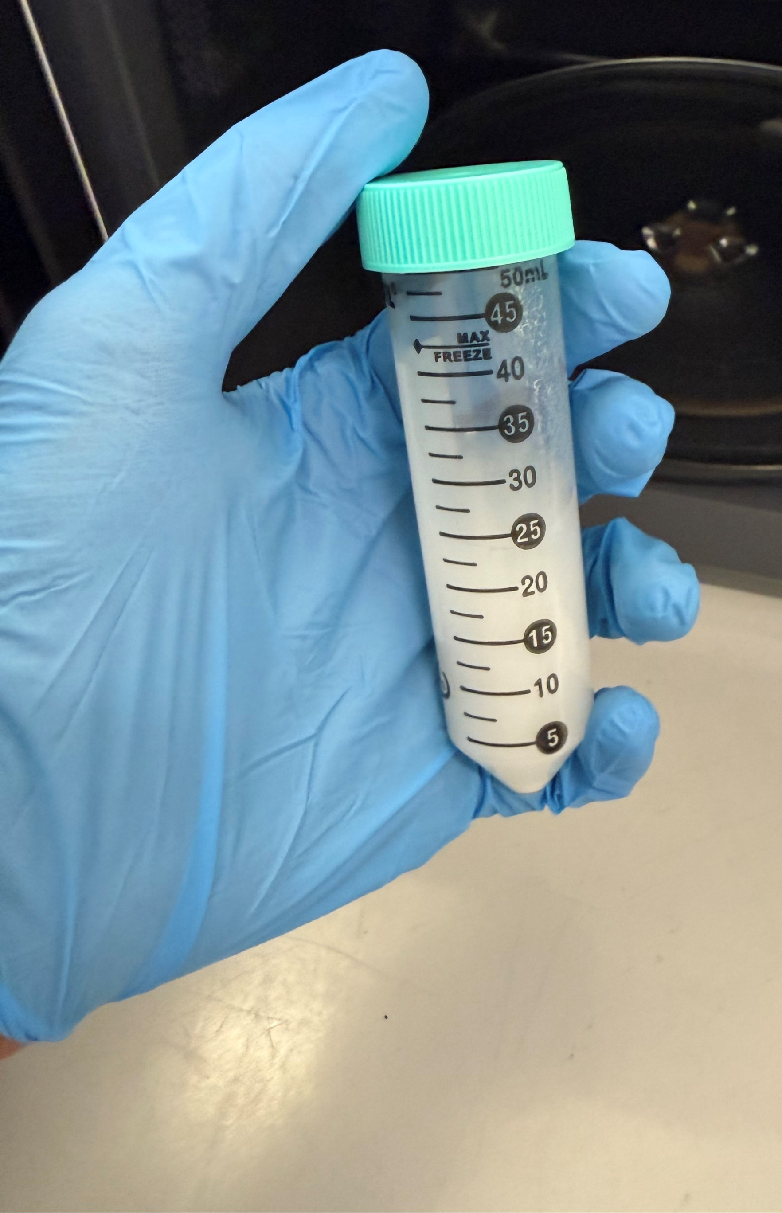
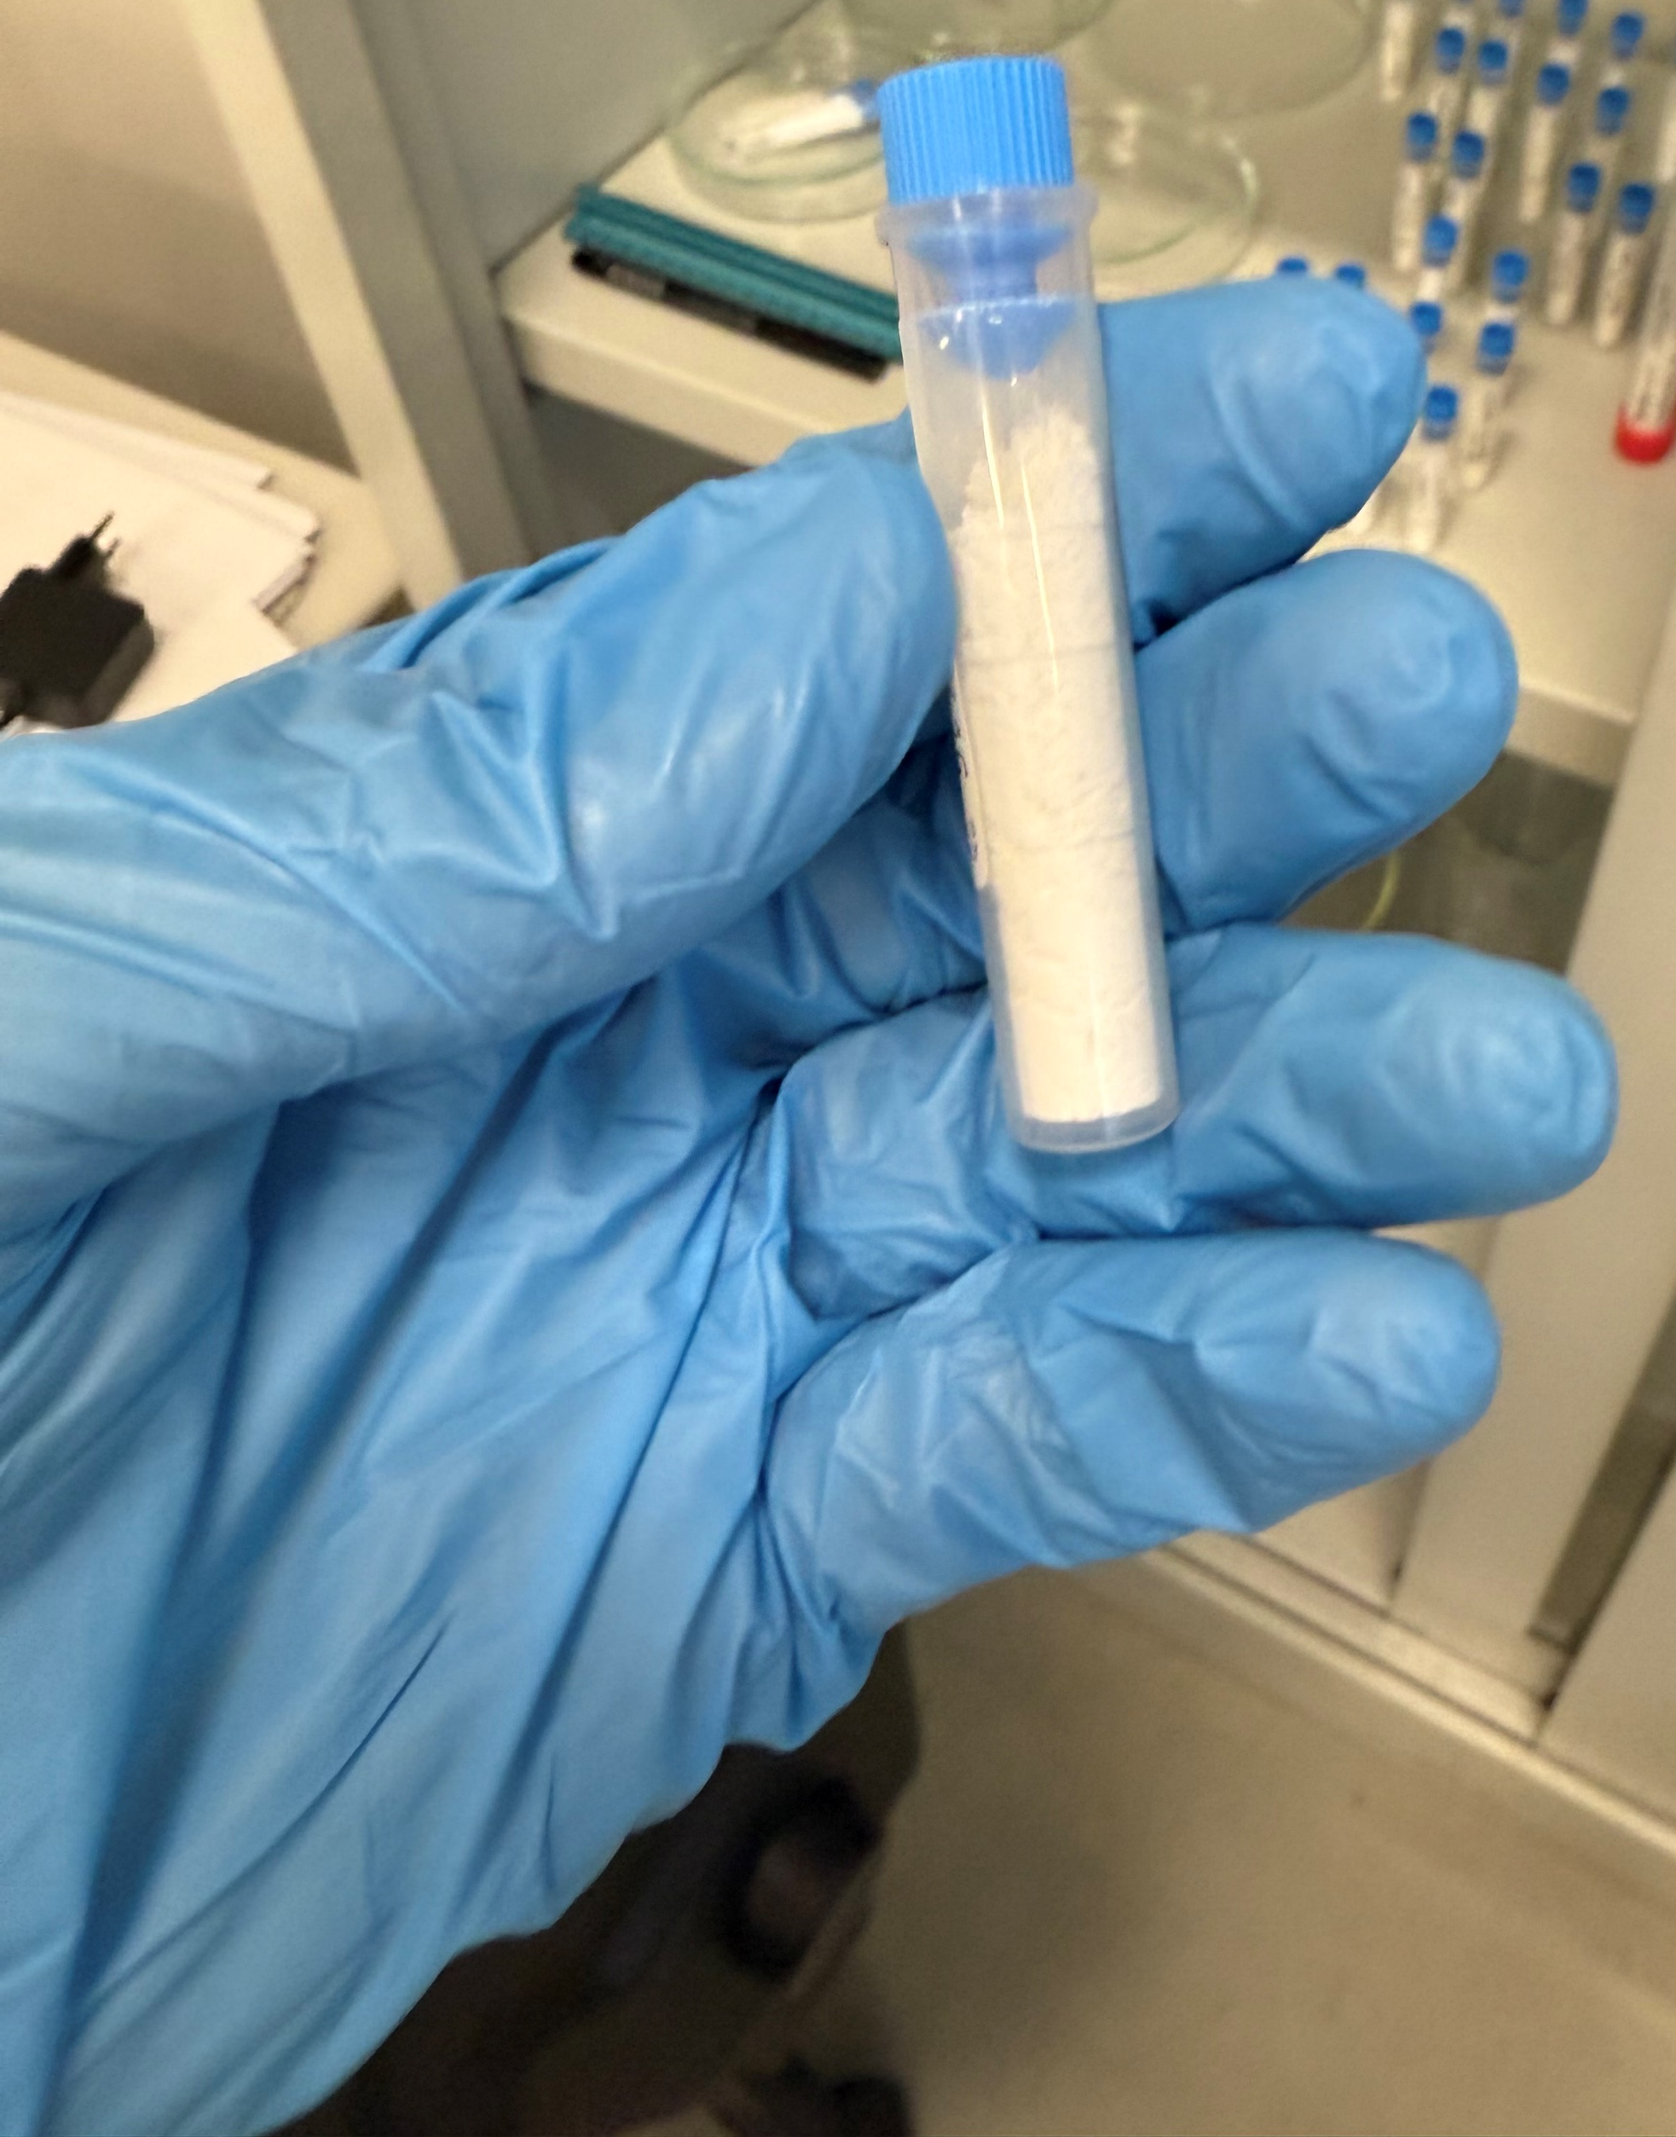
EXPERIMENTAL SET-UP
25mL/min of Portlandite slurry ([Ca(OH)₂] = 23.26g/L)
In ≈1 min slurry fully injected into the chamber
CO₂ flow rate ≈9.5 L/min → saturate the MW oven chamber in ≈1 min
MW Power = 800W
4 min in the microwave to dry the slurry completely
Dried
product
Portlandite
slurry

Slide 10
TEST METHODOLOGY
What are the most optimal conditions for carbon capture in this set-up?
CO₂ EXPOSURE TIME
EFFECT OF MICROWAVES
SLURRY INJECTION METHOD:
→ DROPWISE ADDITION
→ SPRAY INJECTION

Slide 11
RESULTS
effect of CO₂ exposure time
SPRAY
DROP
Spray
Drop
4 min
4 min
3 min
3 min
2 min
2 min
Calcite
Calcite
Portlandite
Portlandite
Portlandite reagent
Portlandite ref.
Calcite
In just 4 min, using only CO₂, yields ≈70–90%
Spray injection of the slurry results in higher yields after just 2 min → catalytic effect of the spray
Carbonate produced: Calcite

Slide 12
RESULTS
… Switch ON the microwaves
SPRAY
DROP
4 min
4 min
Spray
Drop
3 min
3 min
2 min
2 min
Aragonite
Aragonite
ONLY CO₂
Calcite
Calcite
Portlandite
Portlandite
In just 3 min, yields >90%
Microwaves lead to higher yields after just 2 min → ≈ 70-80%
Carbonate produced: Calcite and Aragonite
The presence of aragonite is related to microwaves heating

Slide 13
CONCLUSIONS
Spray produces smaller droplets → higher area/volume → promotes the absorption of CO₂ → increase the yield
Microwaves induce localised heating, inside the drop → increase the reaction kinetics → increase the yield
Aragonite is a metastable form of CaCO₃ → favored by high temperatures and supersaturation regime → microwaves induces evaporation and supersaturation of the system → increase the % of aragonite phase
Complete conversion to carbonates in <4 minutes
With our system, we have 0.55 g of Portlandite which, under optimal conditions, captures 0.25–0.33 g of CO₂ in 4 minutes, producing 0.55–0.7 g of carbonate → In a scale-up system, with 1 kg of Portlandite slurry, we can capture 0.45–0.6 kg of CO₂ every 4 min and produce 1–1.3 kg of carbonates

Slide 14
THANK YOU FOR YOUR ATTENTION

Slide 15
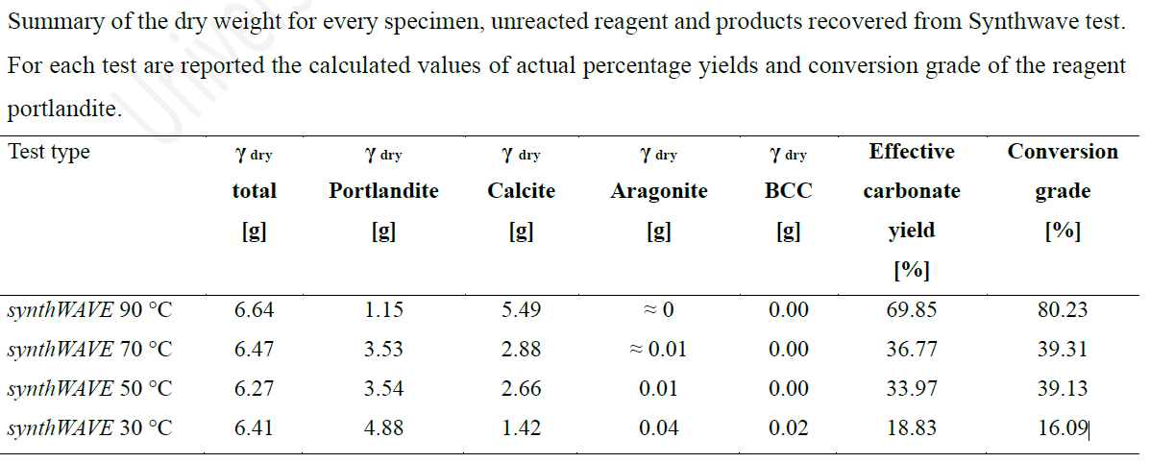
TEST WITH SYNTHWAVE

Slide 16
TEST WITH BRUCITE
4 min with CO₂ + MW spray
4 min with CO₂ + MW drops
Brucite reagent
Brucite ref.

Slide 17
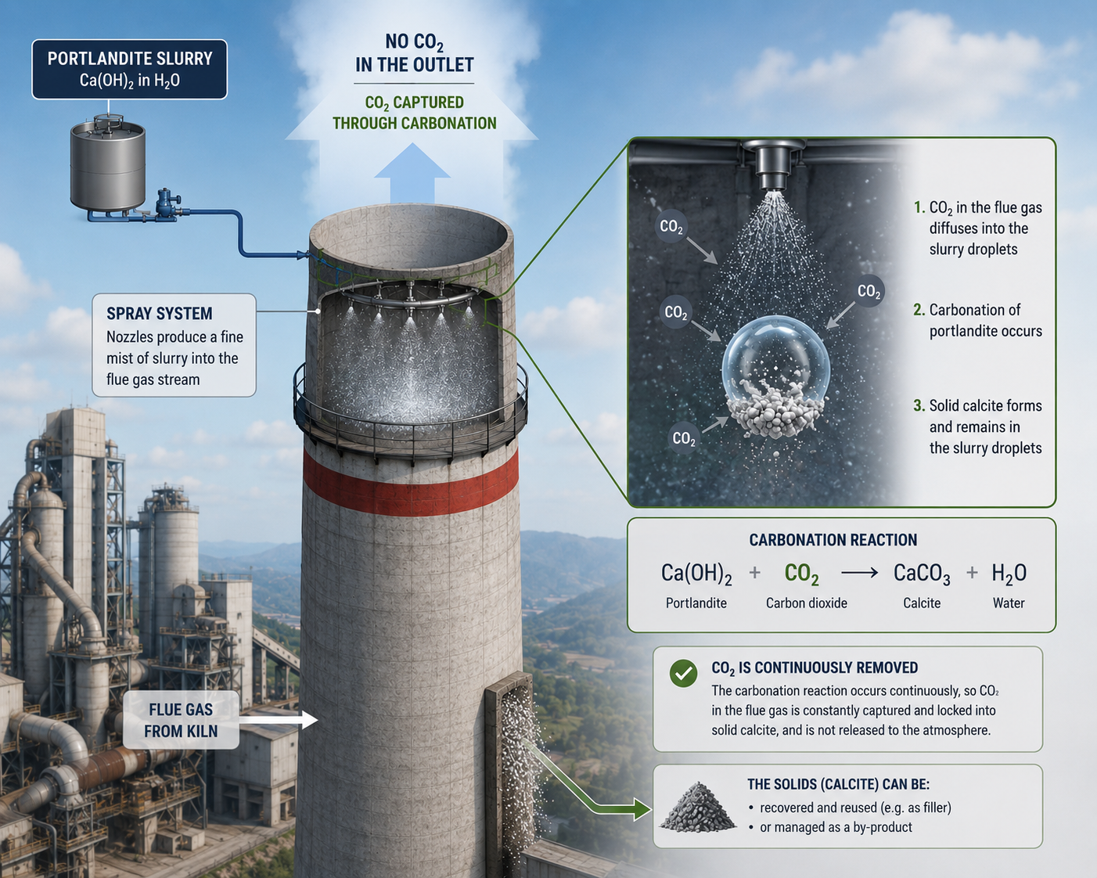
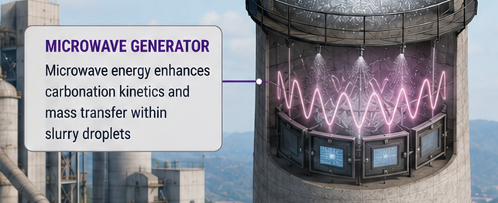
CONCLUSIONS
A highly dispersed portlandite slurry is injected into the flue gas stream, generating a large gas–liquid interfacial area and promotes CO₂ absorption in the droplets.
Simultaneously, microwave irradiation is applied to enhance carbonation kinetics, → increasing CO₂ capture efficiency and accelerating the conversion of Ca(OH)₂ into CaCO₃

